Slide 1
Name comes from “Humongous” & huge data
Written in C++
The American software company 10gen began developing MongoDB in 2007 as a component of a planned platform-as-a-service product.
In 2009, the company shifted to an open-source development model and began offering commercial support and other services. In 2013, 10gen changed its name to MongoDB Inc.
Goal: bridge the gap between key-value stores (which are fast and scalable) and relational databases (which have rich functionality).

Slide 2
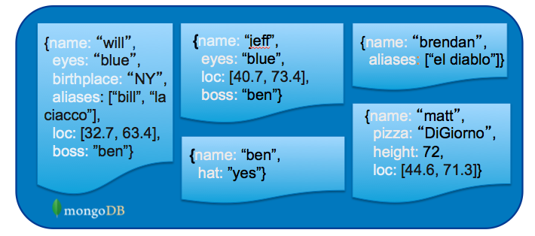
What is MongoDB?
Definition: MongoDB is an open source, document-oriented database designed with both scalability and developer agility in mind.
Instead of storing your data in tables and rows as you would with a relational database, in MongoDB you store JSON-like documents with dynamic schemas (schema-free, schemaless).

Slide 3
What is MongoDB? (Cont’d)
Document-Oriented DB
Unit object is a document instead of a row (tuple) in relational DBs

Slide 4
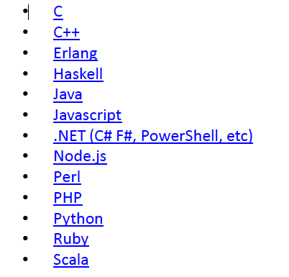
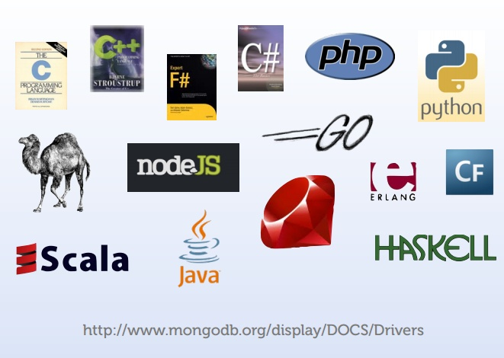
Integration with Others

Slide 5
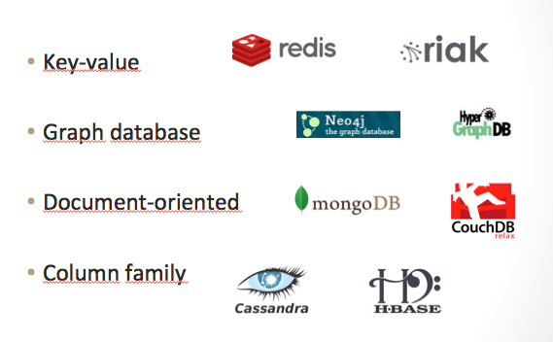
NoSQL: Categories

Slide 6
What is NoSQL
Stands for Not Only SQL??
Class of non-relational data storage systems.
Usually do not require a fixed table schema nor do they use the concept of joins.
Distributed data storage systems.
All NoSQL offerings relax one or more of the ACID properties.
CAP theorem.

Slide 7
CAP Theorem
Three properties of a system
Consistency (all copies have same value)
Availability (system can run even if parts have failed)
All nodes can still accept reads and writes
Partition Tolerance (Even if part is down, others can take over)
CAP “Theorem”:
You can have at most two of these three properties for any system
Pick two !!!

Slide 8
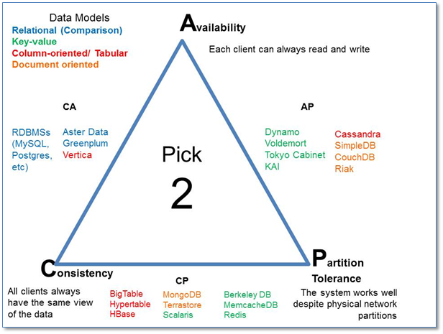
CAP Theorem

Slide 9
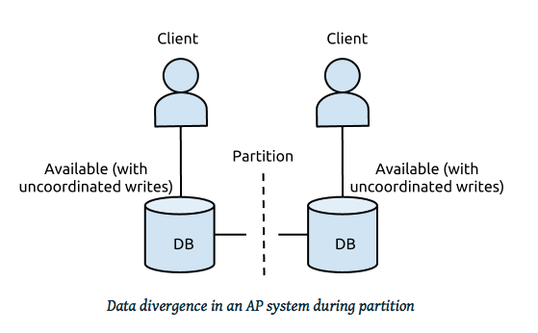
Example
In distributed systems, CA is not a choice
Either select AP or CP
Network Failure
If select Availability ➔ Loose Consistency (AP Design)
If select Consistency ➔ Loose Availability (CP Design)

Slide 10
Availability
Traditionally, thought of as the server/process available five 9’s (99.999 %).
Failures are rare
In modern commodity distributed systems:
Want a system that is resilient in the face of network disruption
Use Replication

Slide 11
Eventual Consistency
When no updates occur for a long period of time:
Eventually all updates will propagate through the system and all the nodes will be consistent
For a given accepted update and a given node:
Eventually either the update reaches the node or the node is removed from service

Slide 12
Eventual Consistency
BASE Concept
Basically Available, Soft state, Eventual consistency
Basically Available - This property refers to the fact that the database system should always be available to respond to user requests, even if it cannot guarantee immediate access to all data. The database may experience brief periods of unavailability, but it should be designed to minimize downtime and provide quick recovery from failures.
Soft state - This property refers to the fact that the state of the database can change over time, even without any explicit user intervention. This can happen due to the effects of background processes, updates to data, and other factors. The database should be designed to handle this change gracefully, and ensure that it does not lead to data corruption or loss.
Eventual consistency - This property refers to the eventual consistency of data in the database, despite changes over time. In other words, the database should eventually converge to a consistent state, even if it takes some time for all updates to propagate and be reflected in the data.

Slide 13


What does NoSQL Not Provide?
No built-in join
No ACID transactions
No SQL
ISA
Follows

Slide 14
Data Model
BSON format (binary JSON)
Developers can easily map to modern object-oriented languages without a complicated ORM layer.
An object-relational mapper provides an object-oriented layer between relational databases and object-oriented programming languages without having to write SQL queries
lightweight, traversable, efficient.

Slide 15
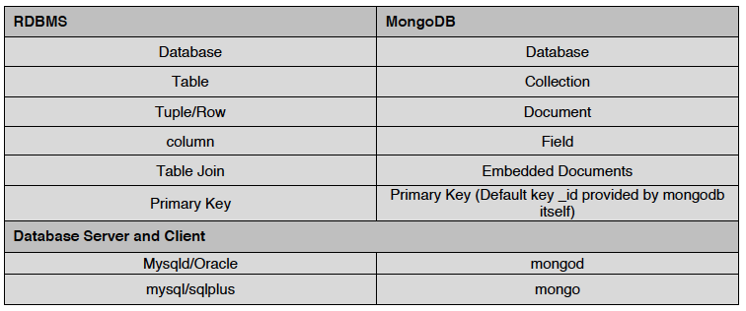
Terms Mapping (DB vs. MongoDB)

Slide 16
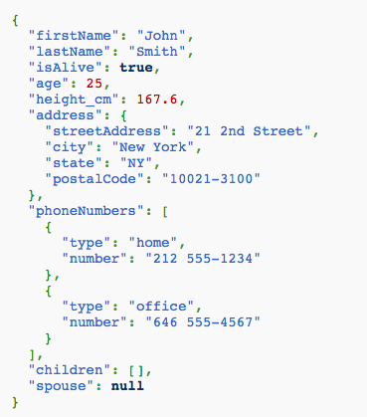
JSON
Field Name
Field Value
Field Value
Scalar (Int, Boolean, String, Date, …)
Document (Embedding or Nesting)
Array of JSON objects
One document

Slide 17
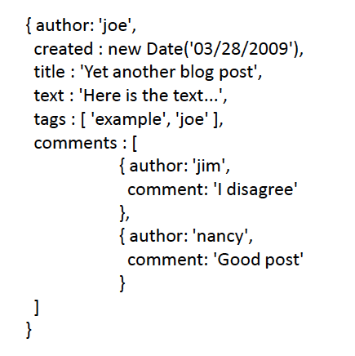
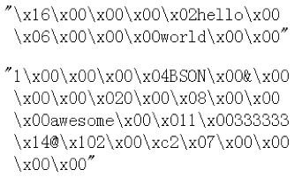
Another Example
Remember it is stored in binary formats (BSON)

Slide 18
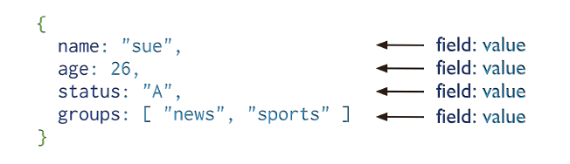
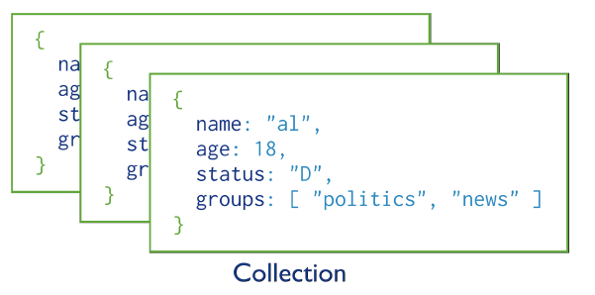
MongoDB Model
One document (e.g., one tuple in RDBMS)
Collection is a group of similar documents
Within a collection, each document must have a unique Id
One Collection (e.g., one Table in RDBMS)
Unlike RDBMS:
No Integrity Constraints in MongoDB

Slide 19
MongoDB Model
One document (e.g., one tuple in RDBMS)
The field names cannot start with the $ character
The field names cannot contain the . character
Max size of single document 16MB
One Collection (e.g., one Table in RDBMS)

Slide 20
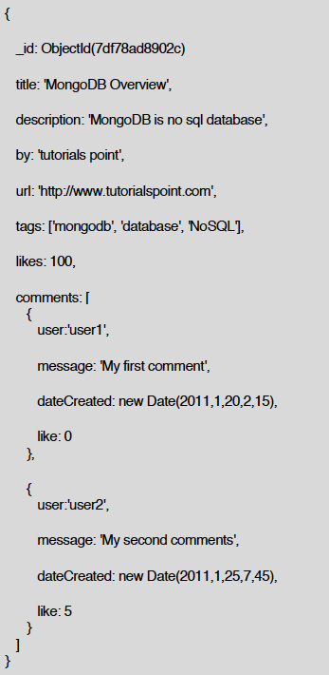
Example Document in MongoDB
_id is a special column in each document
Unique within each collection
_id ⬅➔ Primary Key in RDBMS
_id is 12 Bytes, you can set it yourself
Or:
1st 4 bytes ➔ timestamp
Next 3 bytes ➔ machine id
Next 2 bytes ➔ Process id
Last 3 bytes ➔ incremental values

Slide 21
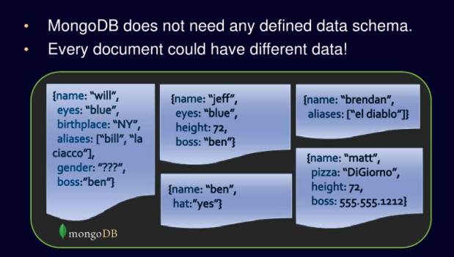
No Defined Schema (Schema-free Or Schema-less)

Slide 22
Data Model Comparison Relational DB vs. NoSQL

Slide 23
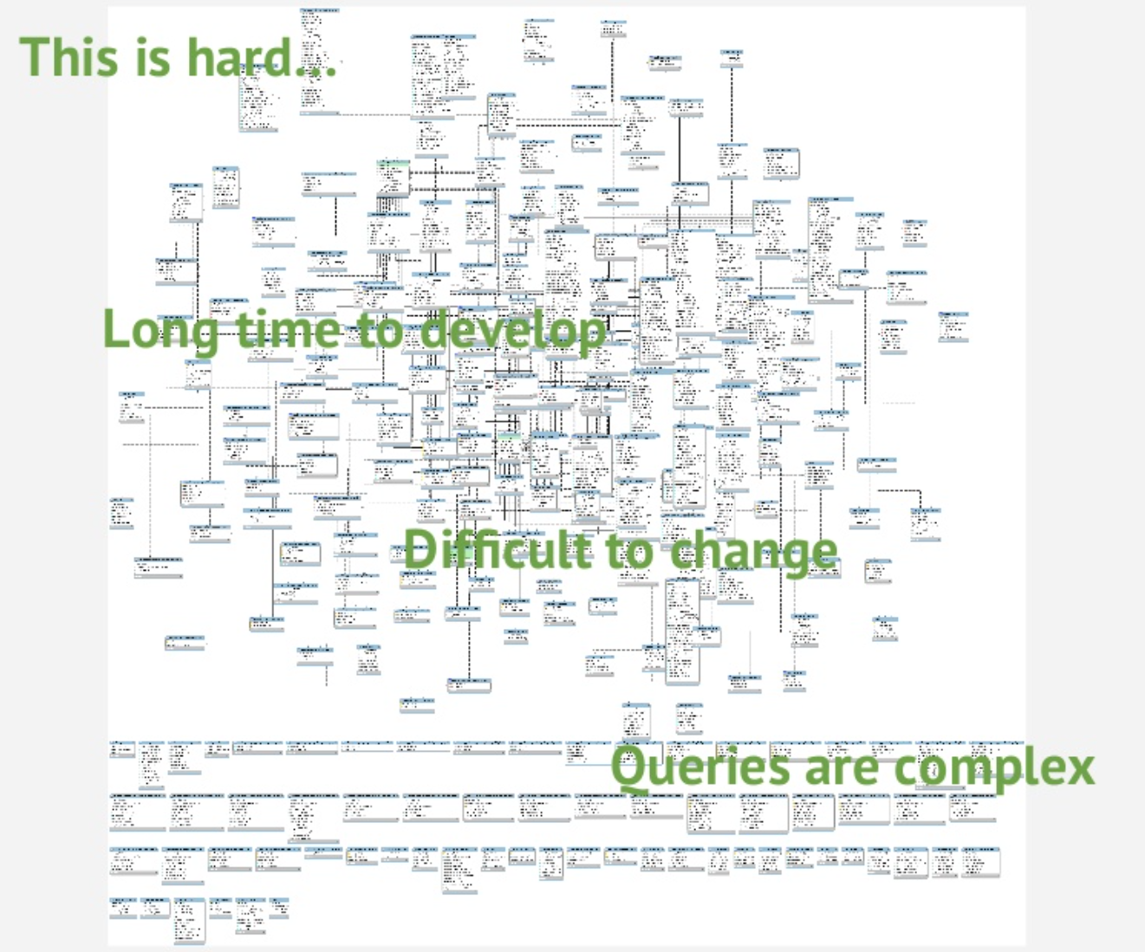
Complex relationships
Dynamic environment
RDBMS are not the best choice

Slide 24
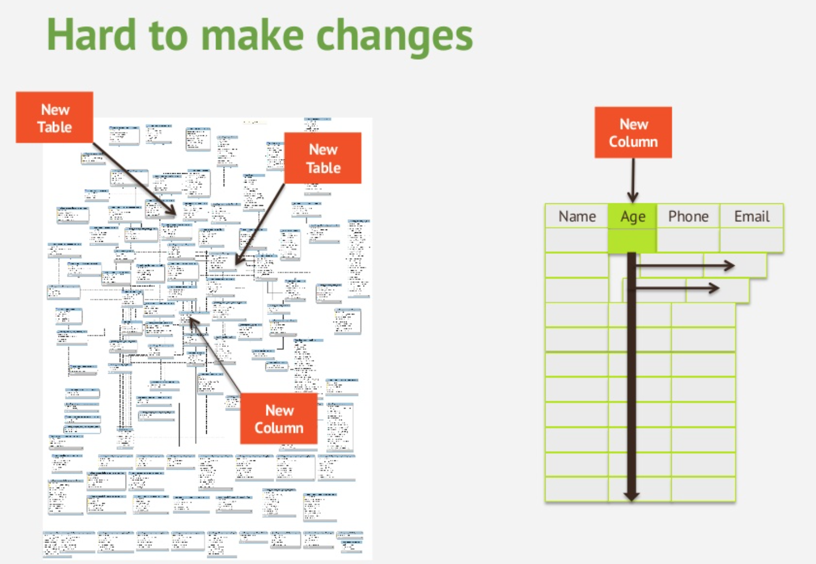

Slide 25
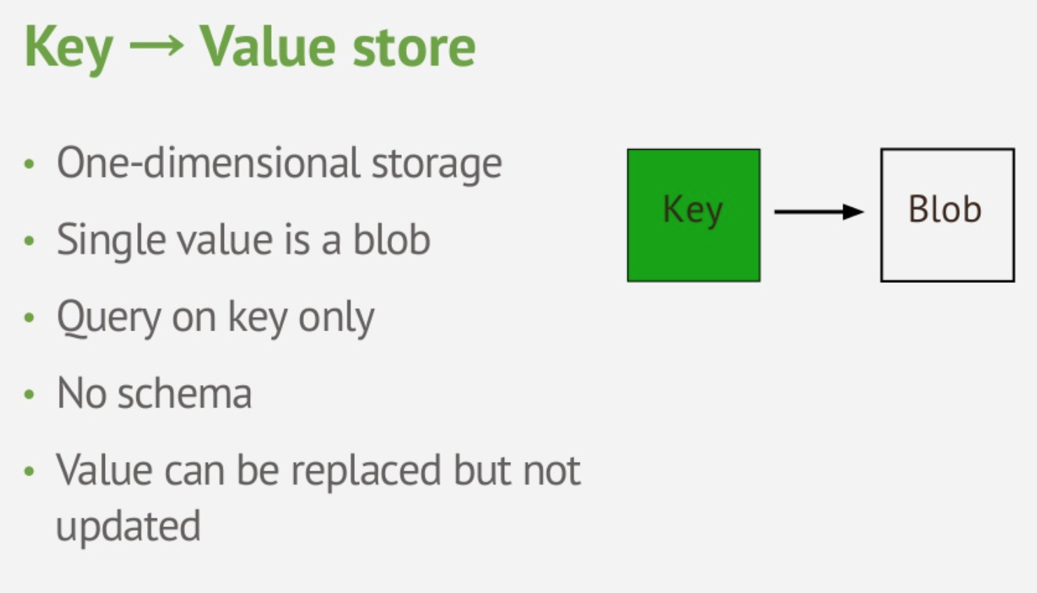
Key-Value Data Model

Slide 26
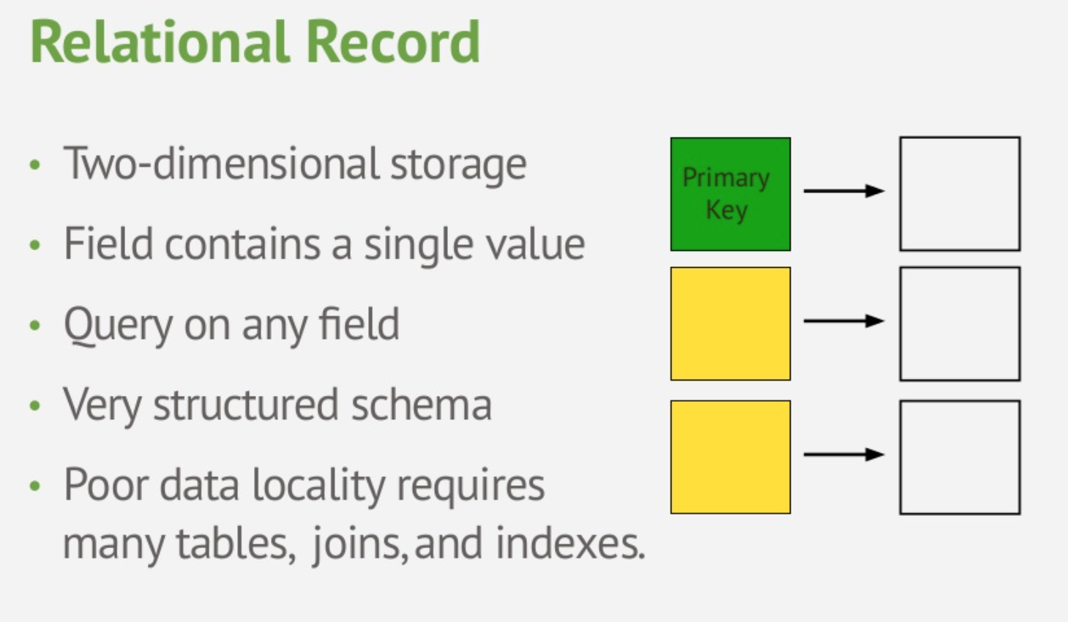
Relational Data Model

Slide 27
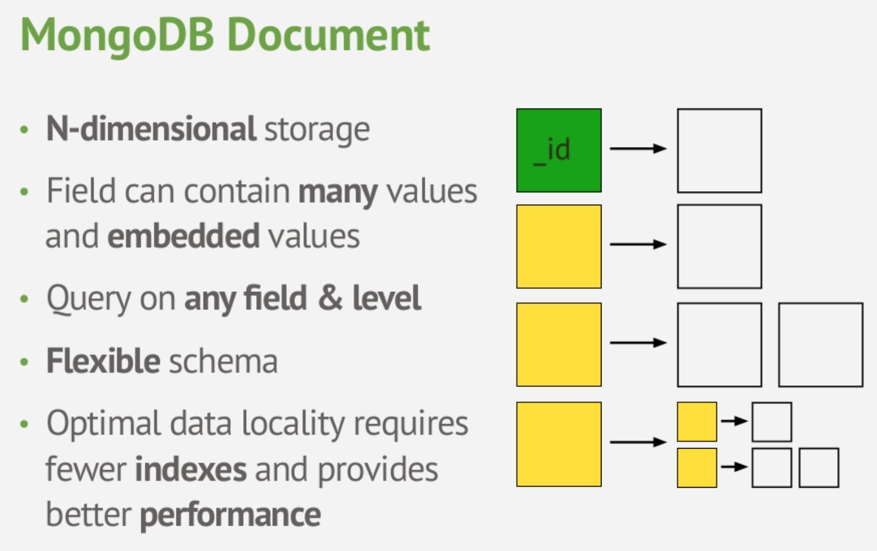
Document Data Model

Slide 28
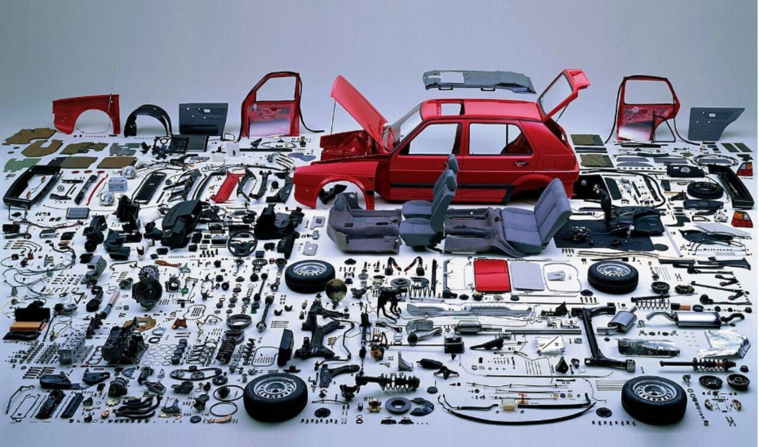
Document vs. Relational Models
Relational
Focus on data storage
At query time ➔ build your business objects
Document
Focus on data usage
Always maintain your business object

Slide 29
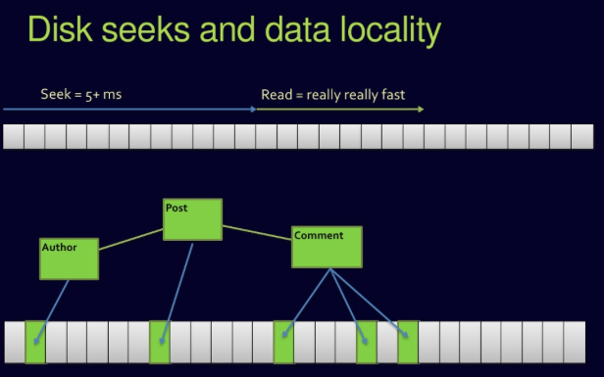
Complex Join Queries
Relational DBs

Slide 30
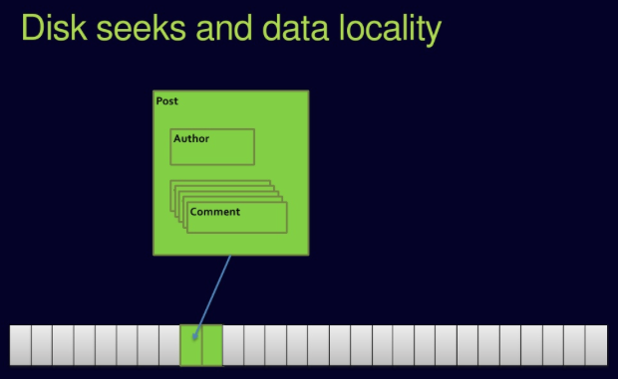
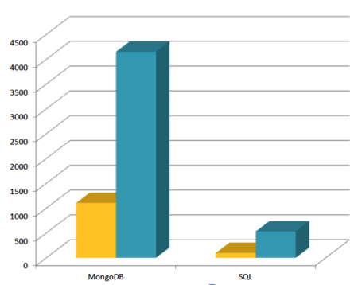
No Joins in MongoDB

Slide 31
Updates & Querying

Slide 32



Must Practice It
Install it
Practice simple stuff
Move to complex stuff
Install it from here: http://www.mongodb.org
Manual: http://docs.mongodb.org/master/MongoDB-manual.pdf
(Focus on Ch. 3, 4 for now)
Dataset: http://docs.mongodb.org/manual/reference/bios-example-collection/

Slide 33
CRUD
Create
db.collection.insert( <document> )
db.collection.save( <document> )
db.collection.update( <query>, <update>, { upsert: true } )
Read
db.collection.find( <query>, <projection> )
db.collection.findOne( <query>, <projection> )
Update
db.collection.update( <query>, <update>, <options> )
Delete
db.collection.remove( <query>, <justOne> )

Slide 34
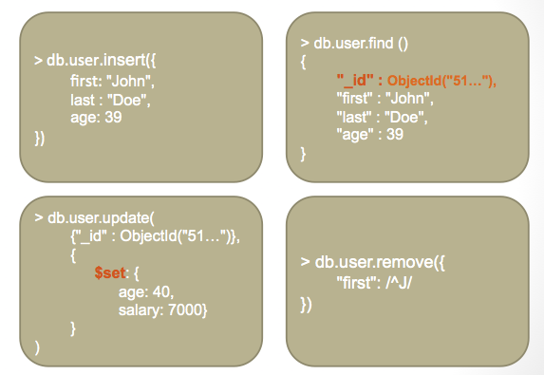
CRUD Examples

Slide 35
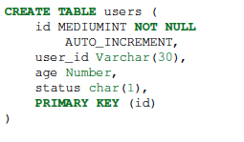
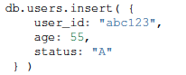

Examples
In RDBMS
In MongoDB
Either insert the 1st document
Or create “Users” collection explicitly

Slide 36
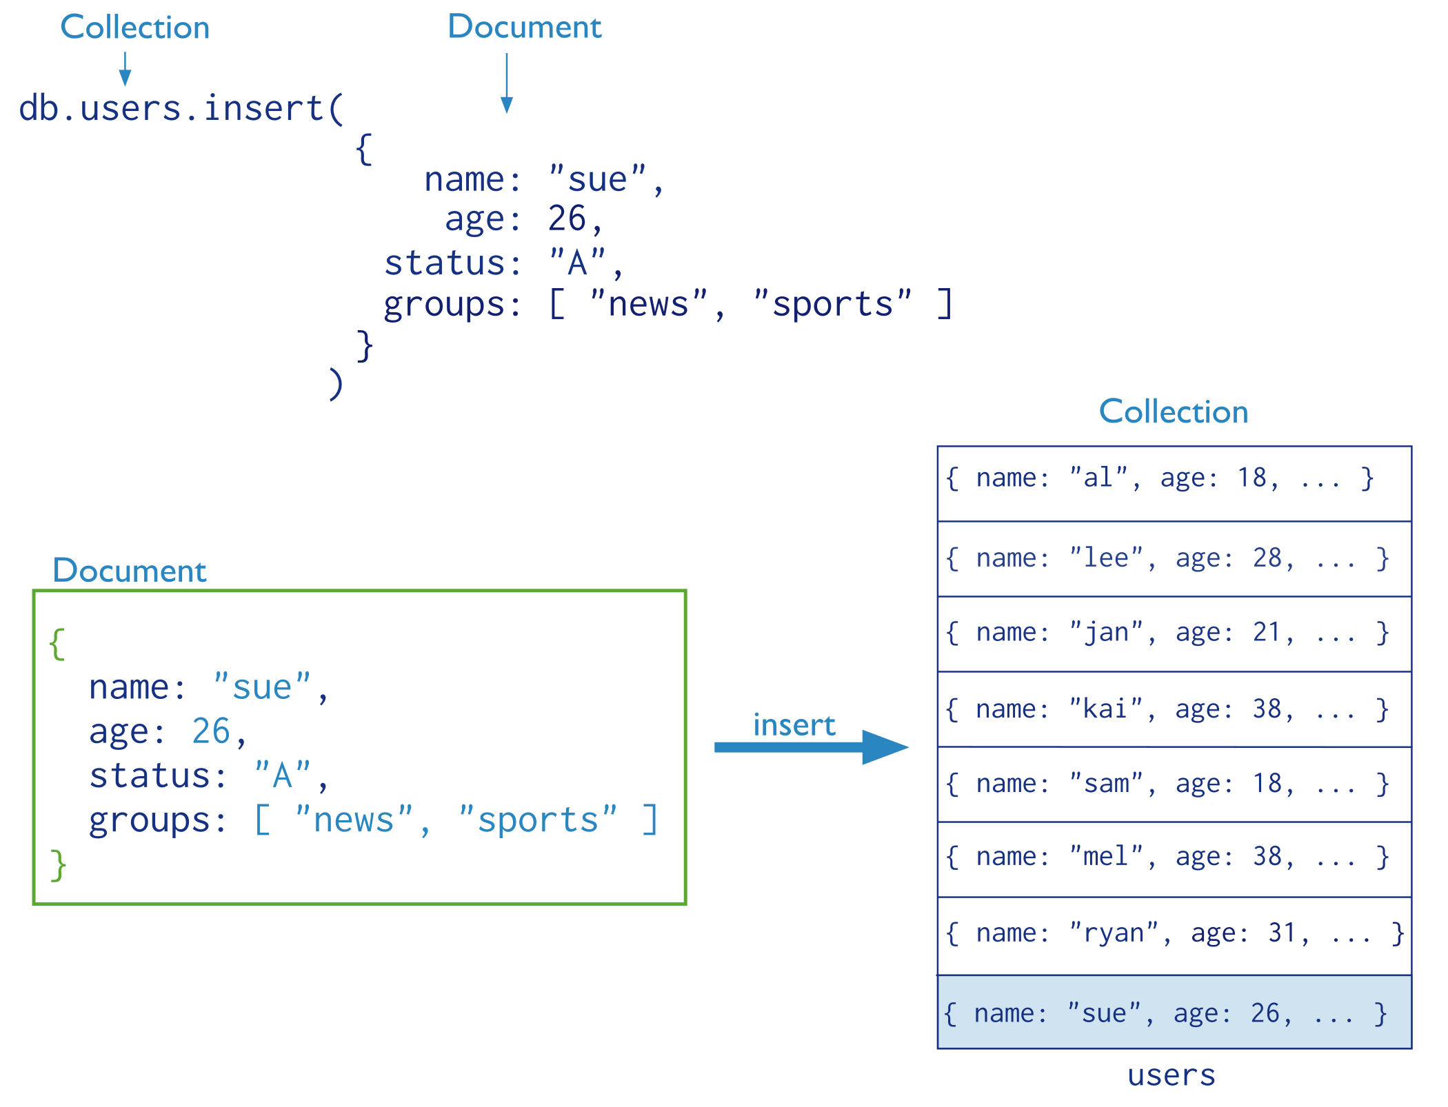
Insertion
The collection “users” is created automatically if it does not exist

Slide 37
Multi-Document Insertion (Use of Arrays)
All the documents are inserted at once

Slide 38
Multi-Document Insertion (Bulk Operation)
A temporary object in memory
Holds your insertions and uploads them at once
There is also Bulk Ordered object
_id column is added automatically

Slide 39
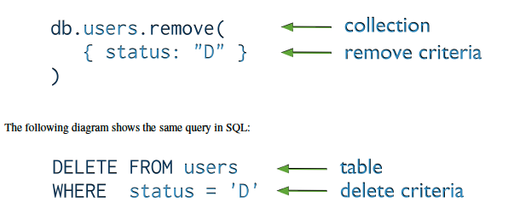
Deletion (Remove Operation)
You can put condition on any field in the document (even _id)
db.users.remove ( )
Removes all documents from users collection

Slide 40
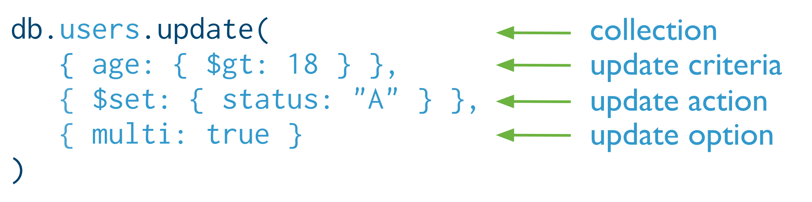

Update
Otherwise, it will update only the 1st matching document
Equivalent to in SQL:

Slide 41
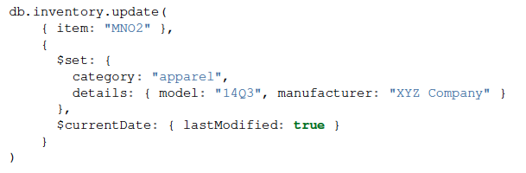
Update (Cont’d)
Two operators

Slide 42
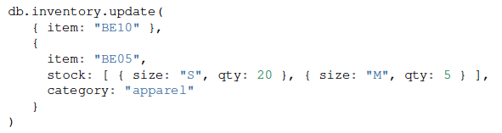
Replace a document
Query Condition
New
doc
For the document having item = “BE10”, replace it with the given document

Slide 43
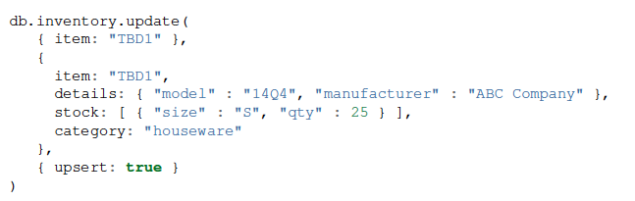
Insert or Replace
The upsert option
If the document having item = “TBD1” is in the DB, it will be replaced
Otherwise, it will be inserted.

